Slide 1

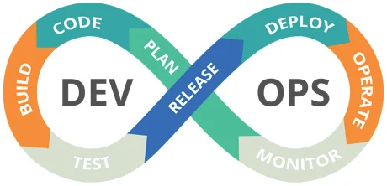
Deploy a Fullstack Application Using Kubernetes and Ansible Playbook
23SDCS13A/R
CI/CD AND CLOUD DEVOPS
Dr.S.SRITHAR B.E.,M.Tech., Ph.D

Slide 2
Why Ansible Playbook?
An Ansible Playbook is a YAML file that defines a series of tasks and configurations to be executed automatically on remote systems. It is used to manage, configure, deploy, and automate systems in a consistent and repeatable way using Ansible.
Automates repetitive tasks: installs Docker, starts Minikube, deploys Kubernetes manifests, and forwards ports automatically.
Saves time: no need to run multiple shell commands manually.
Handles dependencies: checks Docker status, copies manifests, waits for pods.
Background operations: forwards ports so apps stay accessible even if the terminal closes.

Slide 3
Why Playbook?
The playbook:
Ensures Docker is running.
Starts Minikube if not already running.
Deploys the fullstack app to Kubernetes.
Waits until pods are running.
Forwards the NodePort services to localhost in the background.

